Slide 1
Spatial Simulation Experiment: SPASAM Application
Workshop Update
Brian Langseth and Jon Deroba
NOAA Fisheries
March 5, 2023
brian.langseth@noaa.gov jonathan.deroba@noaa.gov

Slide 2
Spatial Processes And Stock Assessment Models (SPASAM)
Developed in ~2016 as a generic simulation/estimation tool
Capable of multiple OM/EM structures: panmictic, heterogeneity, metapopulation, and natal homing
Age-based, assumes annual time step, and instantaneous Markovian movement among areas
EM can fit to tagging data and the usual suite of inputs (e.g., catch, age composition, indices of abundance)
Written in ADMB, but may move to TMB/R with added MSE capacity (our group is actively seeking a post-doc)
Never used for an “actual” stock assessment and a relatively small group of users

Slide 3
Progress since January
Less progress than hoped…only with YFT data
Replaced ALK error structure from lognormal to normal, which resulted in a noticeable plus group within age comps
Reduced the number of fleets in spatial model to try to continue to improve model run time

Slide 4
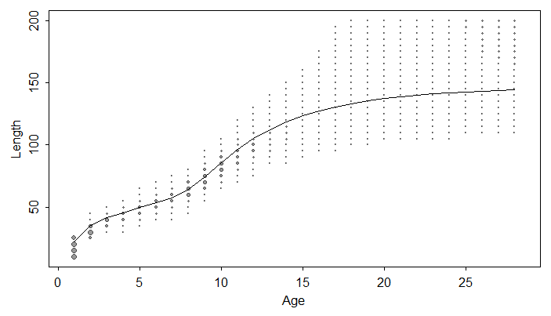
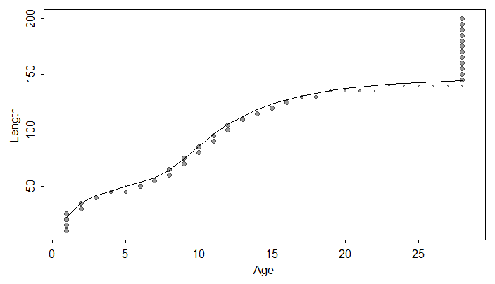
Normal vs Lognormal error for ALK
Had no plus group appear in our age comps for either 1 area or spatial
Found it could be resolved by switching from lognormal error to normal
Lognormal
Normal
Difficult to know distribution for sure without age and length data

Slide 5
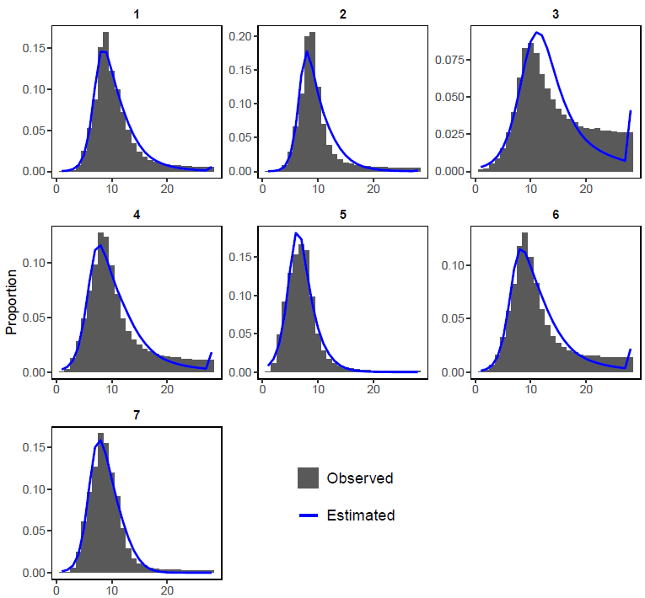
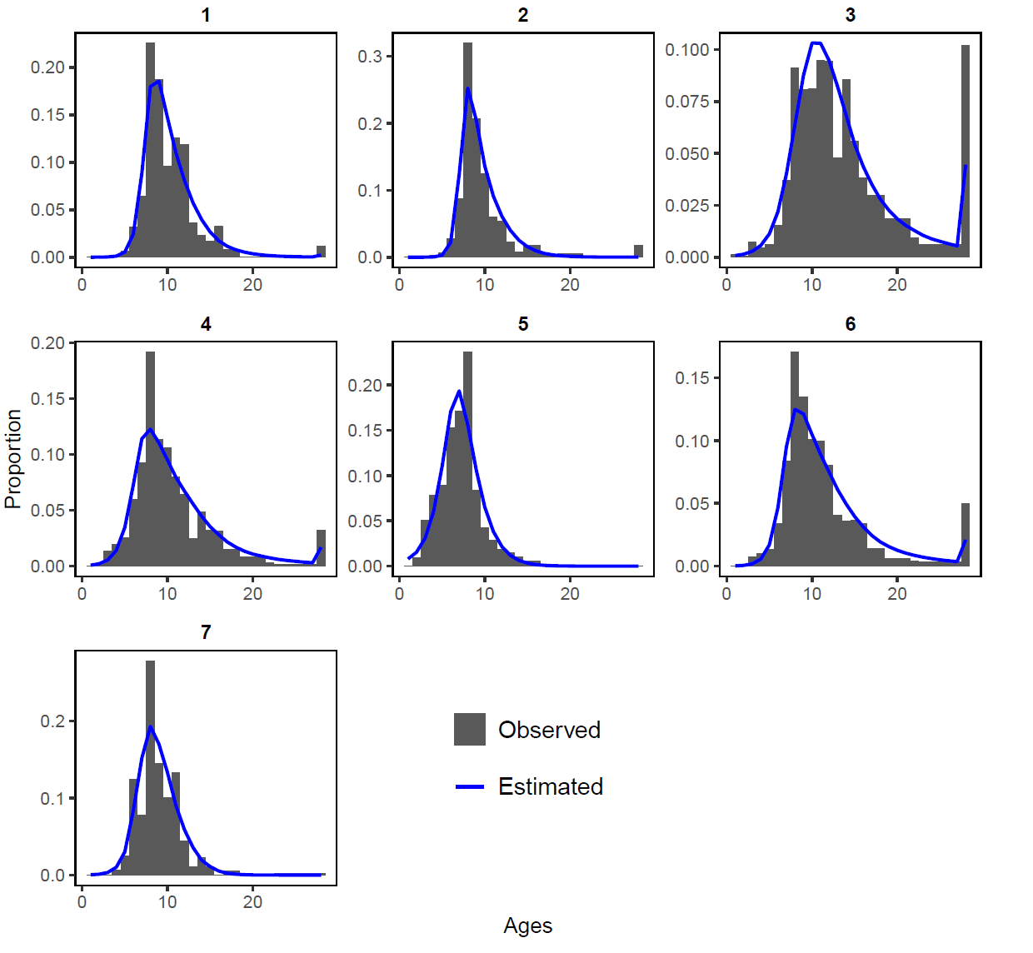
Normal vs Lognormal error for ALK
Had no plus group appear in our age comps for either 1 area or spatial
Found it could be resolved by switching from lognormal error to normal
Lognormal
Normal
Difficult to know distribution for sure without age and length data

Slide 6
Normal vs Lognormal error for ALK
Had no plus group appear in our age comps for either 1 area or spatial
Found it could be resolved by switching from lognormal error to normal
Use normal for provided model runs
Results were similar
More variable recruitment deviations
Much more interpretable comp fits
No real change in model run time (for our spatial model)

Slide 7
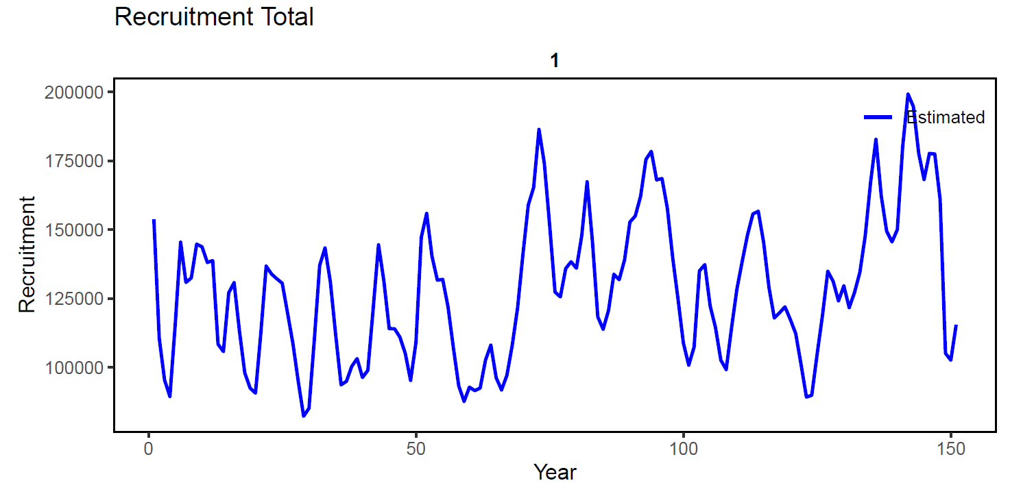
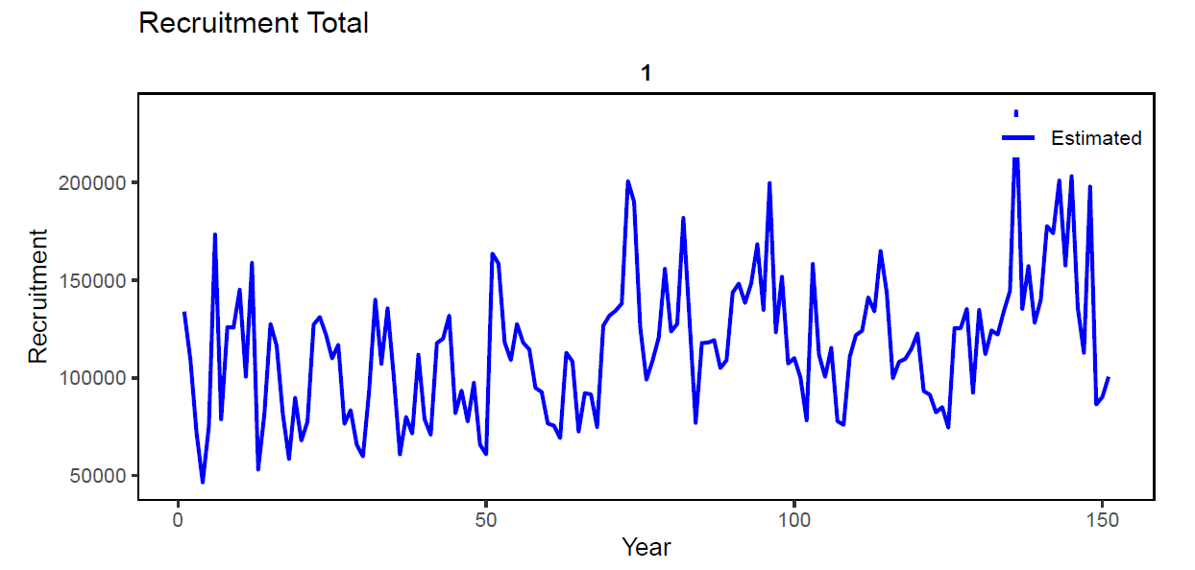
Normal vs Lognormal error for ALK
Lognormal
Had no plus group appear in our age comps for either 1 area or spatial
Found it could be resolved by switching from lognormal error to normal
Use normal for provided model runs
Results were similar
More variable recruitment deviations
Much more interpretable comp fits
No real change in model run time (for our spatial model)
Normal

Slide 8
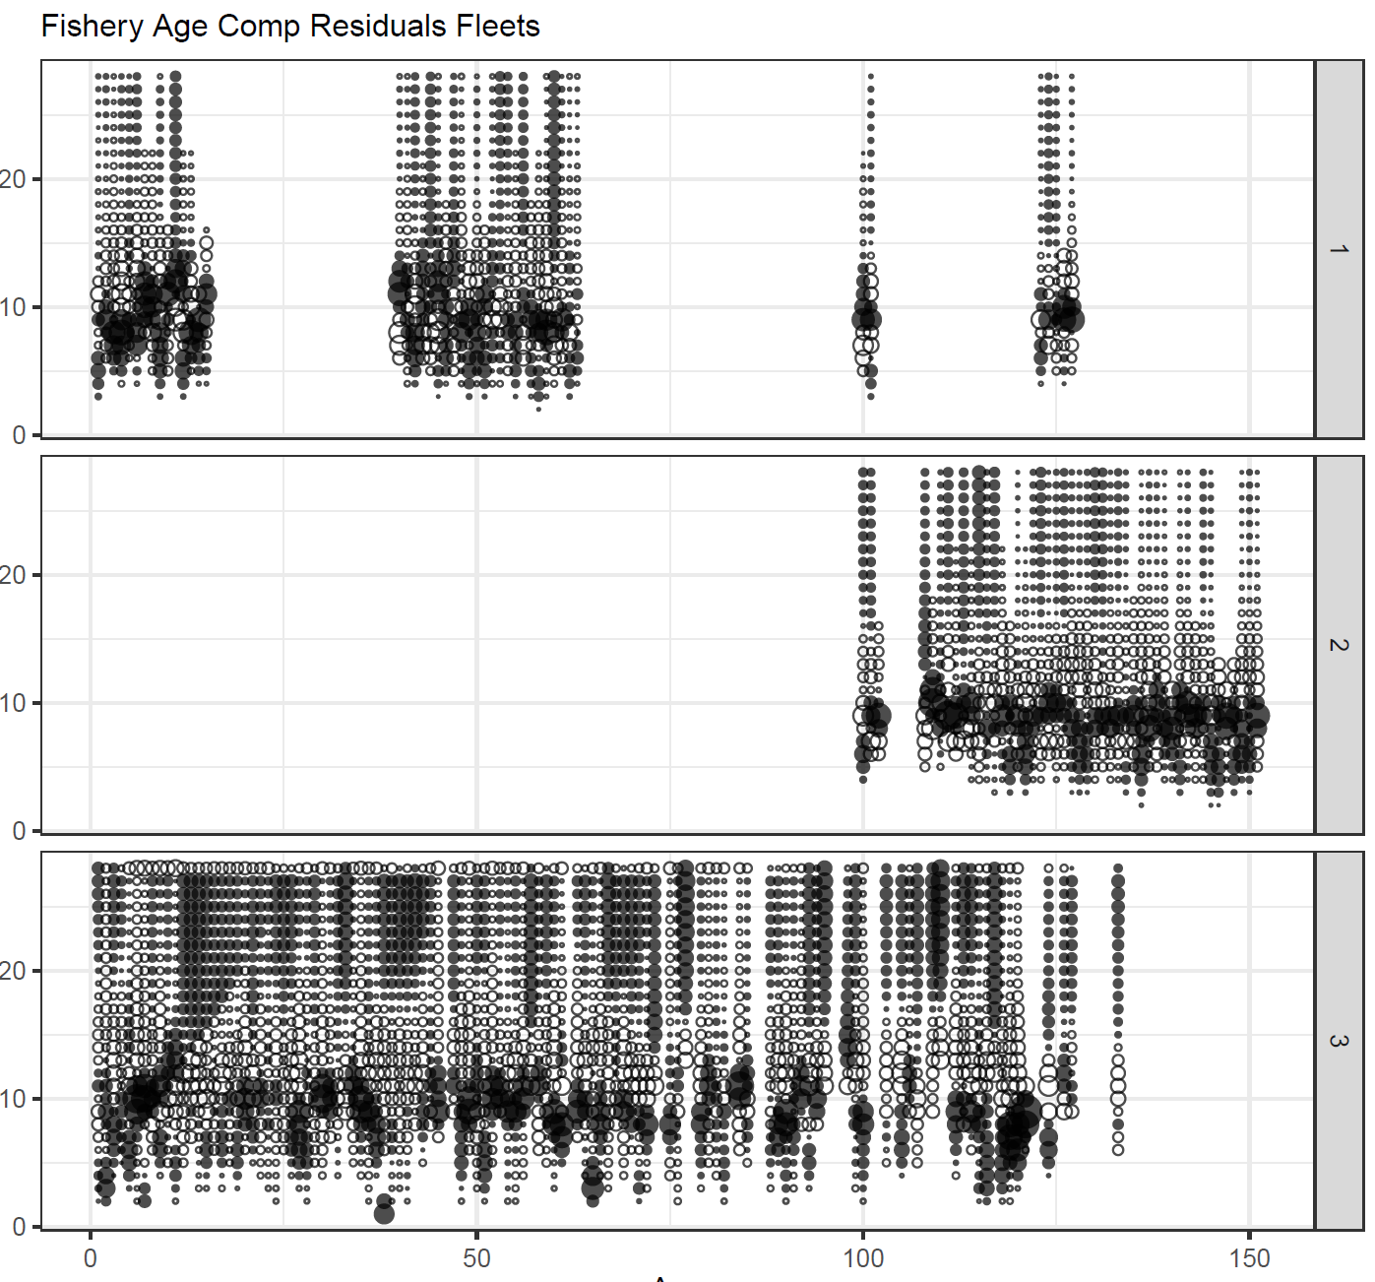
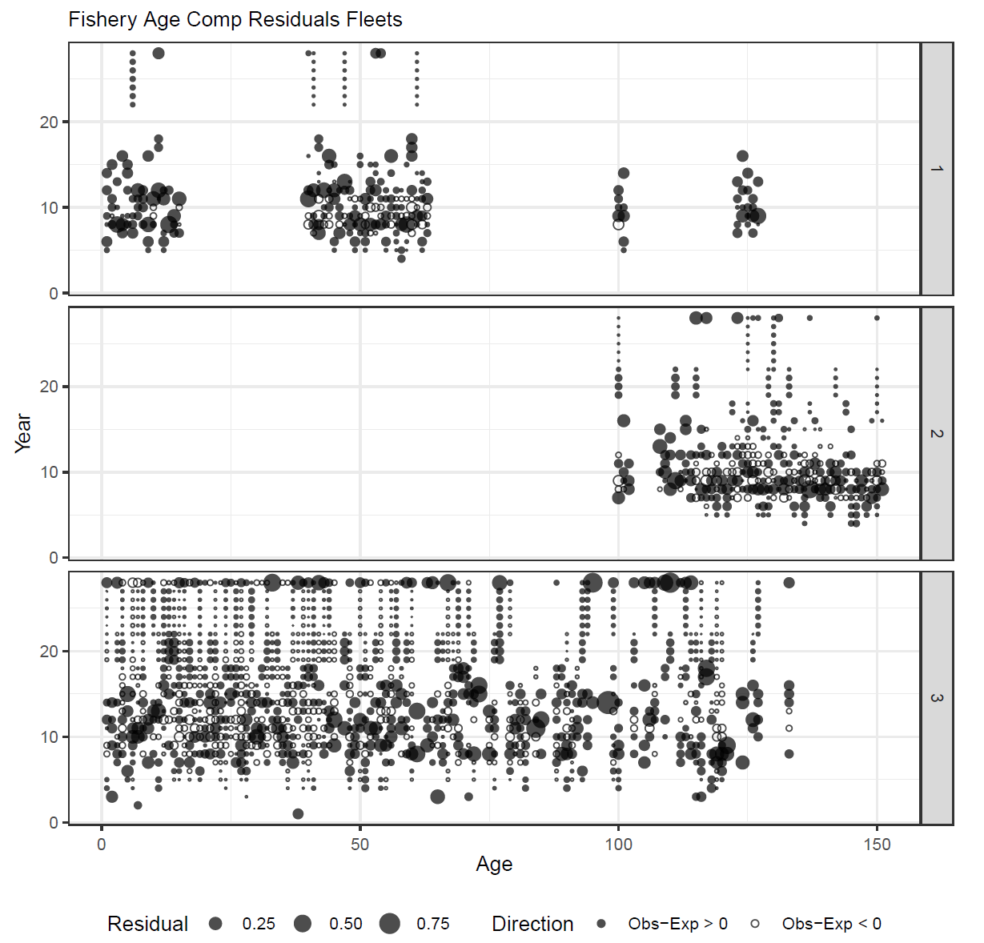
Normal vs Lognormal error for ALK
Lognormal
Normal
Had no plus group appear in our age comps for either 1 area or spatial
Found it could be resolved by switching from lognormal error to normal
Use normal for provided model runs
Results were similar
More variable recruitment deviations
Much more interpretable comp fits
No real change in model run time (for our spatial model)

Slide 9
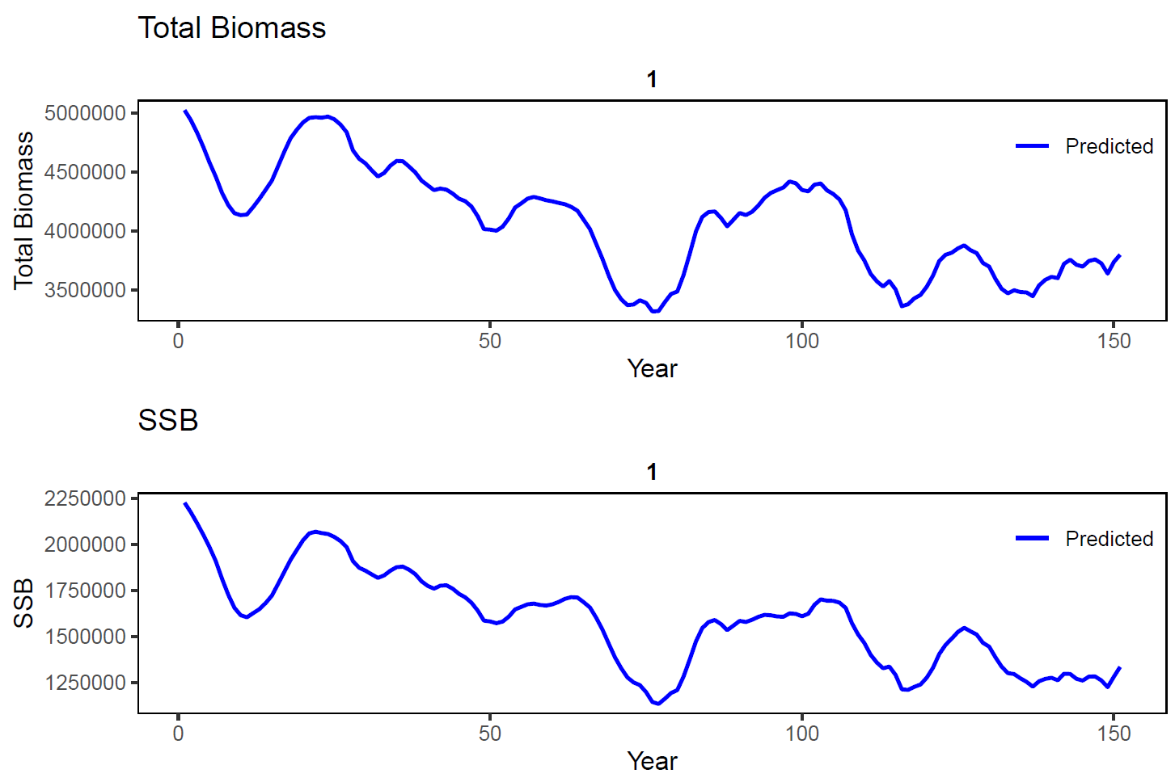
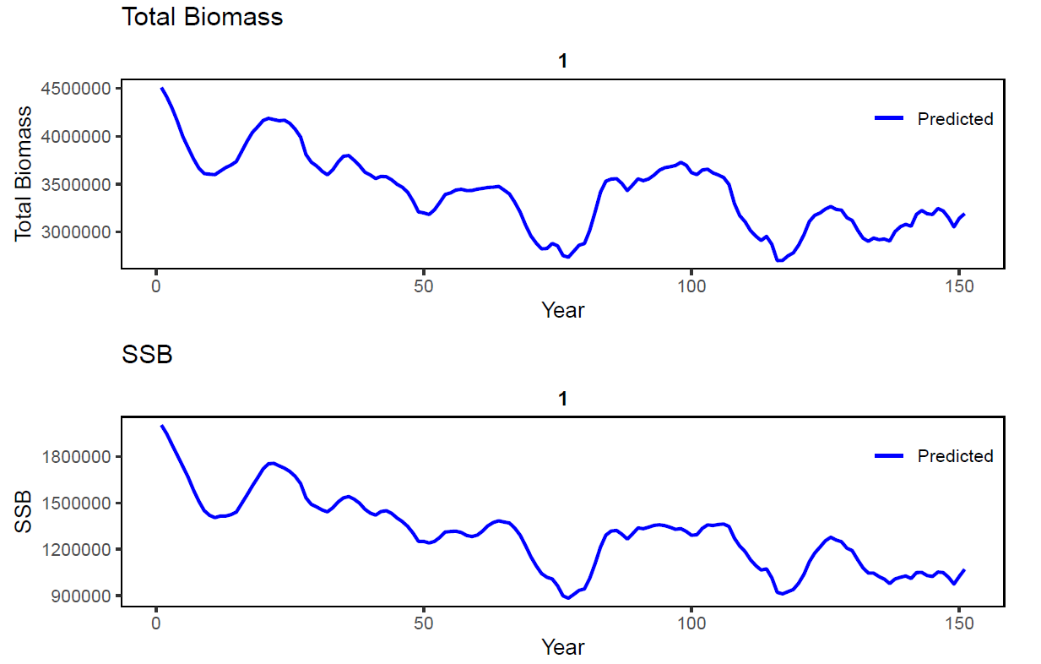
Normal vs Lognormal error for ALK
Had no plus group appear in our age comps for either 1 area or spatial
Found it could be resolved by switching from lognormal error to normal
Use normal for provided model runs
Results were similar
More variable recruitment deviations
Much more interpretable comp fits
No real change in model run time (for our spatial model)
Normal
Lognormal Normal

Slide 10
Reduce number of fleets in spatial model
Continue to be limited by long run times for our modeling platform
4 areas x 7 fleets (~20 hours)
2 areas x 7 fleets (~13 hours)
2 areas x 4 fleets (~5 hours)
Fleet reductions based on explorations from one area model
Use 4 fleet model as provided results
Vastly easier to explore
Notes:
Fleet combinations include Purse Seine, Troll, Other; Longline; Gillnet, handline; and bait

Slide 11
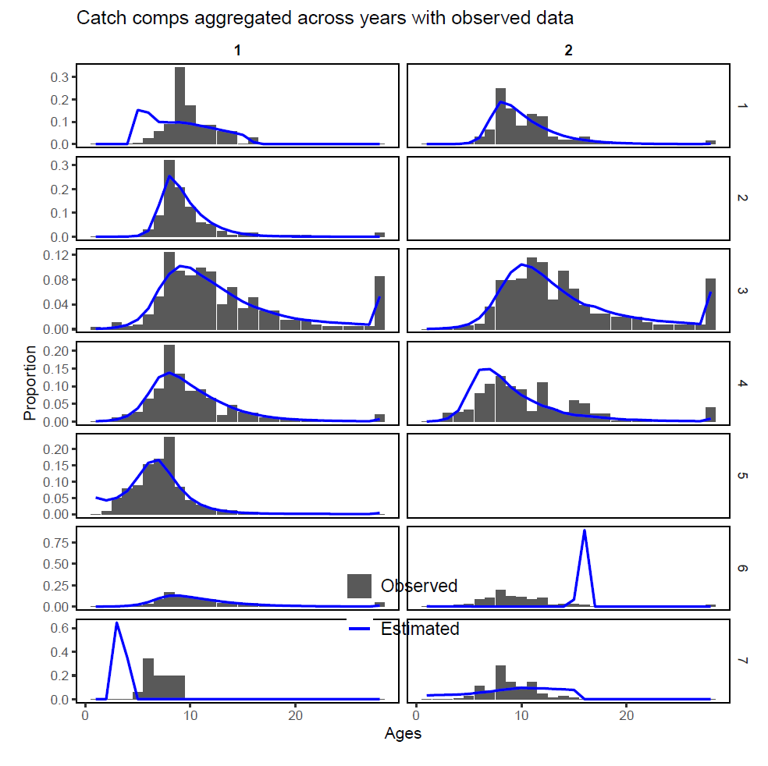
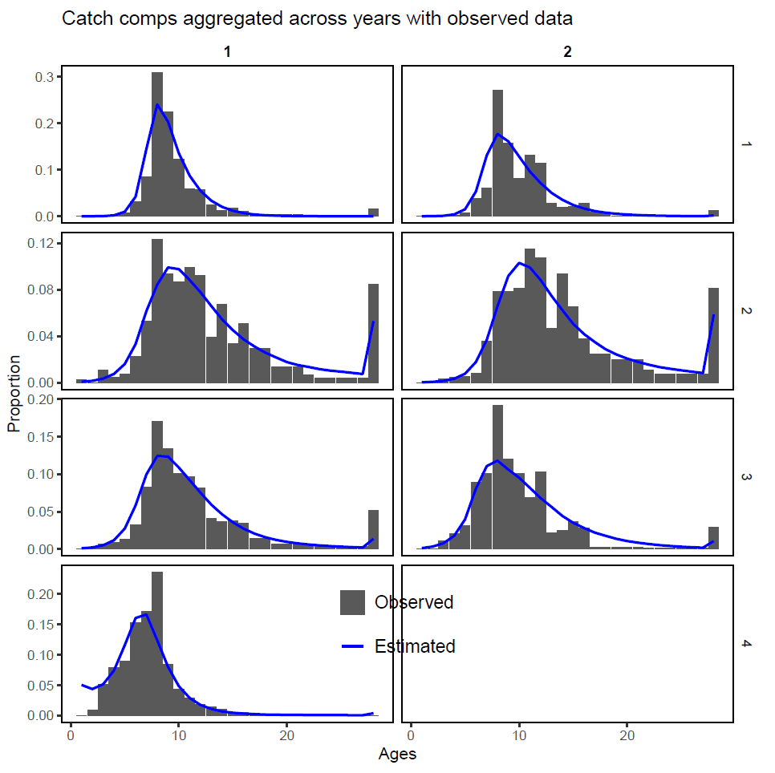
Reduce number of fleets in spatial model
Combined fleets are 1,2,7 and 3 and 4,6 and 5
Notes:
Fleet combinations include Purse Seine, Troll, Other (1,2,7); Longline (3); Gillnet, handline (4,6); and bait (5)

Slide 12
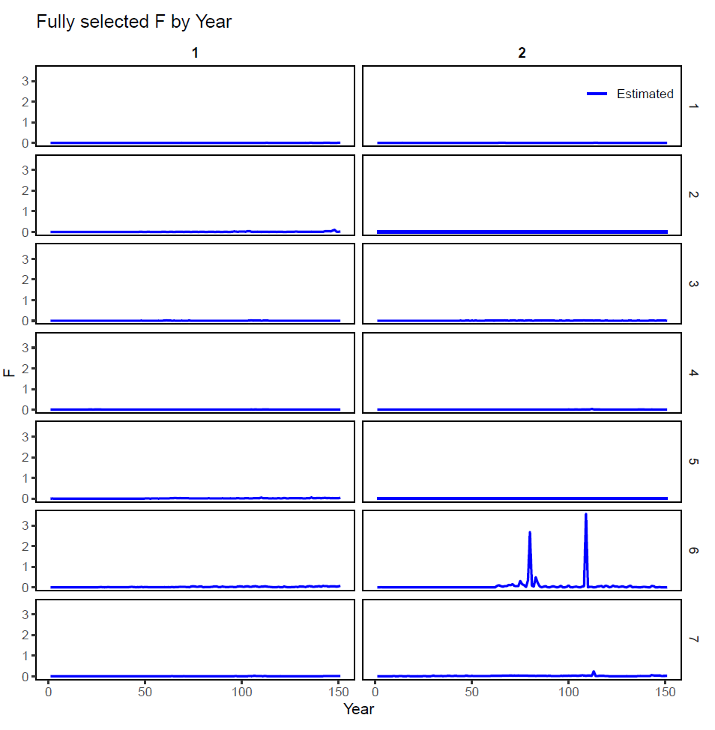
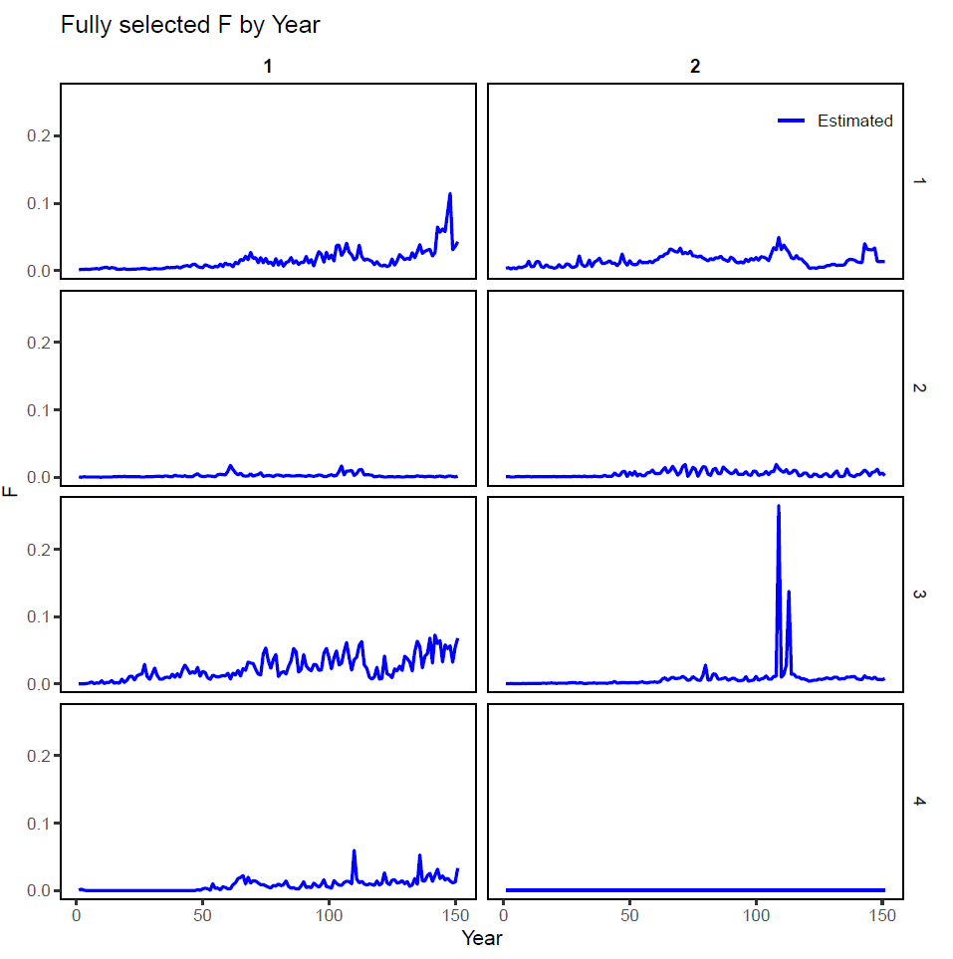
Reduce number of fleets in spatial model
Spikes in F persist when movement is estimated
Combined fleets are 1,2,7 and 3 and 4,6 and 5
Notes:
Fleet combinations include Purse Seine, Troll, Other (1,2,7); Longline (3); Gillnet, handline (4,6); and bait (5)

Slide 13
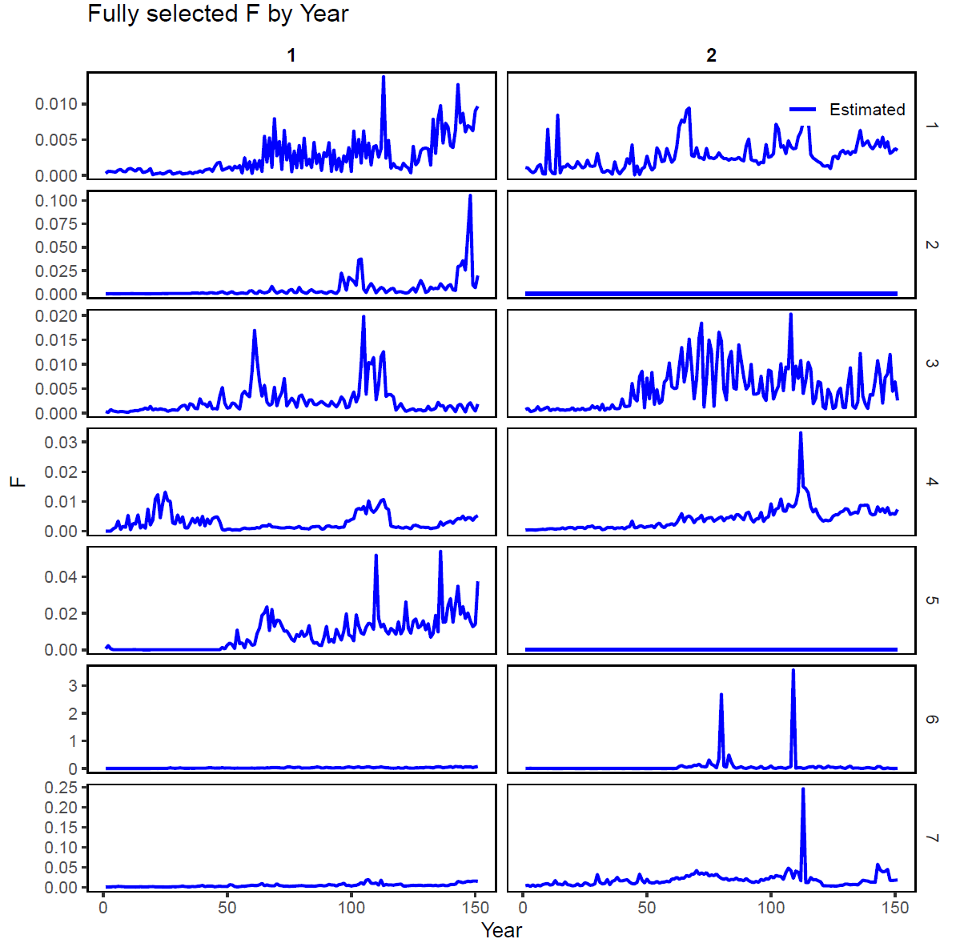
Reduce number of fleets in spatial model
Spikes in F persist when movement is estimated
Combined fleets are 1,2,7 and 3 and 4,6 and 5
Notes:
Fleet combinations include Purse Seine, Troll, Other (1,2,7); Longline (3); Gillnet, handline (4,6); and bait (5)

Slide 14
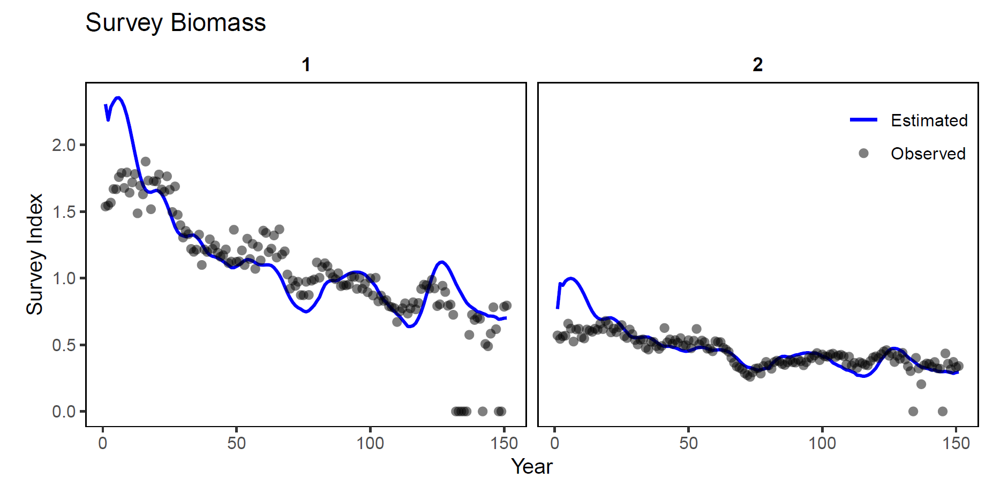
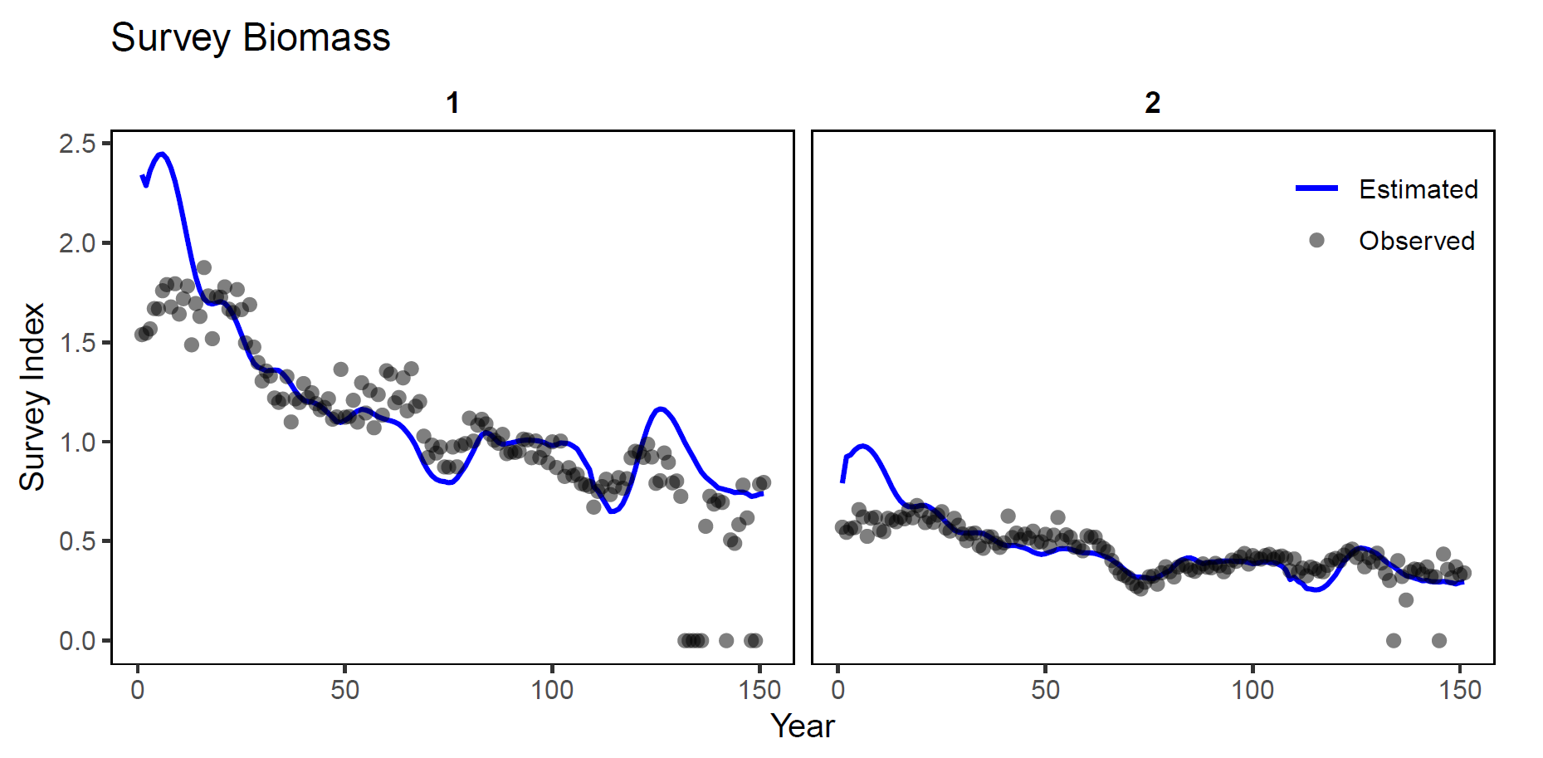
Reduce number of fleets in spatial model
7 fleets
4 fleets

Slide 15
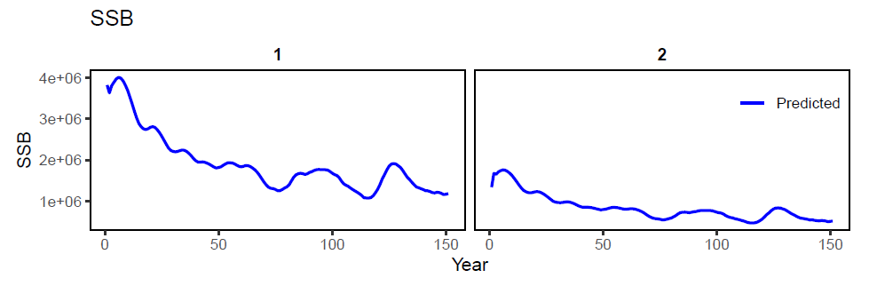
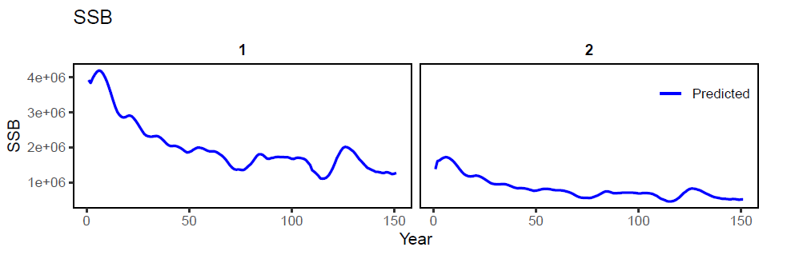
Reduce number of fleets in spatial model
7 fleets
4 fleets

Slide 16
SPASAM: Application to Yellowfin Tuna - Summary
Summary of our experiences to date
Platform limitations remain formidable
Collapsing fleets, deleting years, and combining across areas was useful for early development and reducing run-times; suggest starting simple
Results are similar with these simplifications
More work remains to speed up run time for spatial model

Slide 17
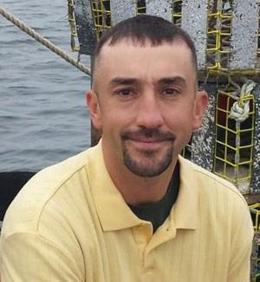



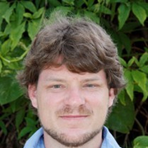


Many thanks!!
Acknowledgments
Amy Schueller
Dan Goethel
Aaron Berger
Dana Hanselman
Katelyn Bosley
NOAA for funding SPASAM

Slide 18
Extra slides

Slide 19
SPASAM: Application to Yellowfin Tuna - 1 area model
Start “simple”
1 area, 7 fleets
no tagging data
no accounting of spatial structure
256 pseudo-years, at least to start
28 pseudo-ages
Age comp calculated using the age-length key provided and SD of length|age = 0.1
Life-history at age fixed at true values provided in Table A1
https://aaronmberger-nwfsc.github.io/Spatial-Assessment-Modeling-Workshop/articles/OM_description_YFT.html

Slide 20
SPASAM: Application to Yellowfin Tuna - 1 area model
Longline selectivity was logistic and all others double logistic, at least to start
Single catchability for longline CPUE, with mirrored selectivity
Recruitment deviations estimated using a penalty from an underlying Bev-Holt with SD = 0.6 (steepness fixed at true value)
Fully-selected F parameter estimated for each fleet and pseudo-year
Abundance-at-age estimated in pseudo-year 1, except recruitment which equaled R0
1,266 parameters (I think)
SE of catches = 0.01 for all fleets and pseudo-years, at least to start
SE of survey = 0.2 in all pseudo-years
ESS = 5 for all fleets and pseudo-years, at least to start

Slide 21
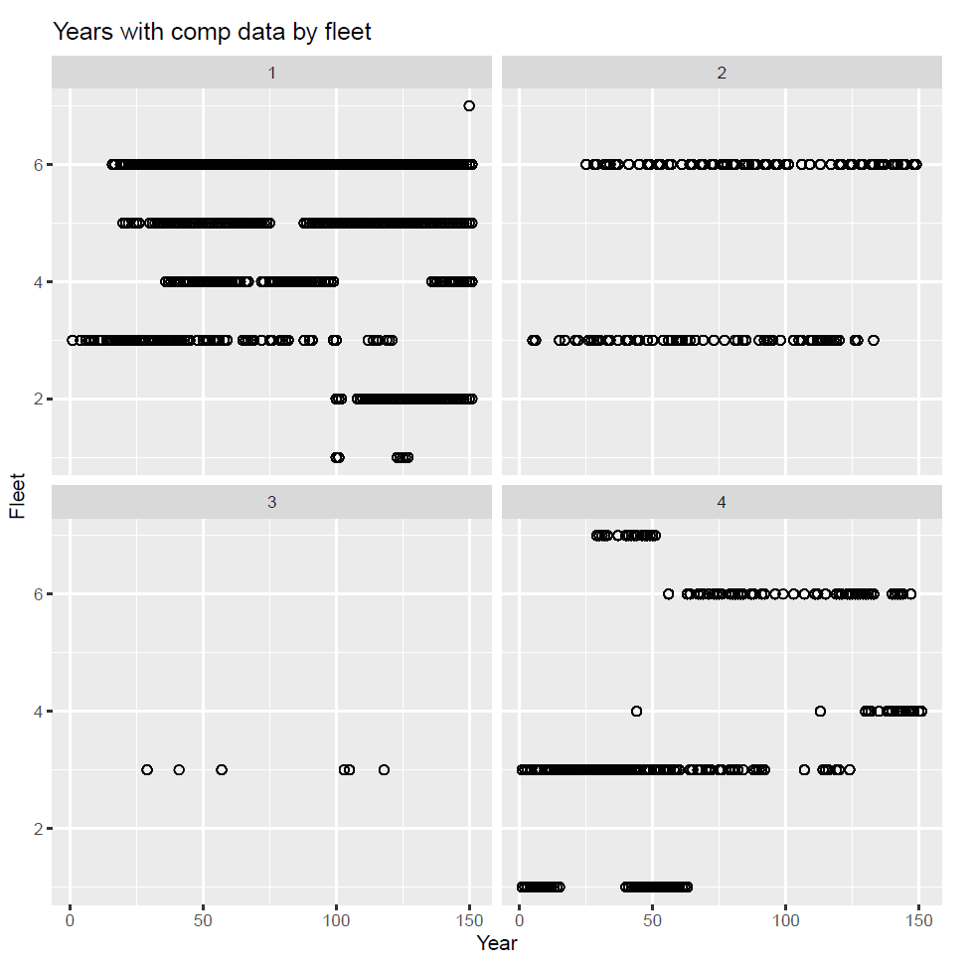
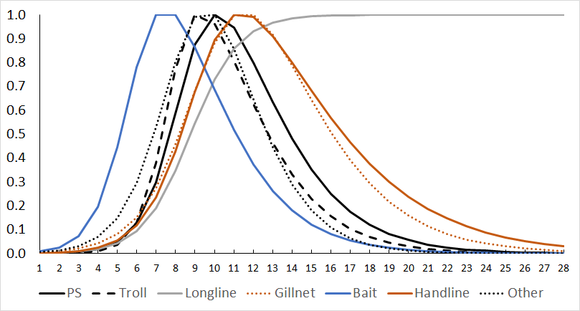
Reduce number of fleets in spatial model
Continue to be limited by long run times for our modeling platform
4 areas x 7 fleets (~20 hours)
2 areas x 7 fleets (~13 hours)
2 areas x 4 fleets (~5 hours)
Vastly easier to explore

Slide 22
SPASAM: Application to Yellowfin Tuna - 2 area model
Start “simple” from best 1-area setup
4 area, 7 fleets
include tagging data
no movement
Assume single SR curve, starting with provided R0
Recruitment apportioned equally among regions
151 pseudo-years
28 pseudo-ages
Keep updates from 1 area exploration
ESS set to 15 or 25, survey se = 0.2
Not estimating initial abundance

Slide 23
SPASAM: Application to Yellowfin Tuna - 2 area model results
Explorations are ongoing - Current best case model
Age-invariant and time-invariant movement added
Movement penalty around ~80% residency stabilized estimation

Slide 24
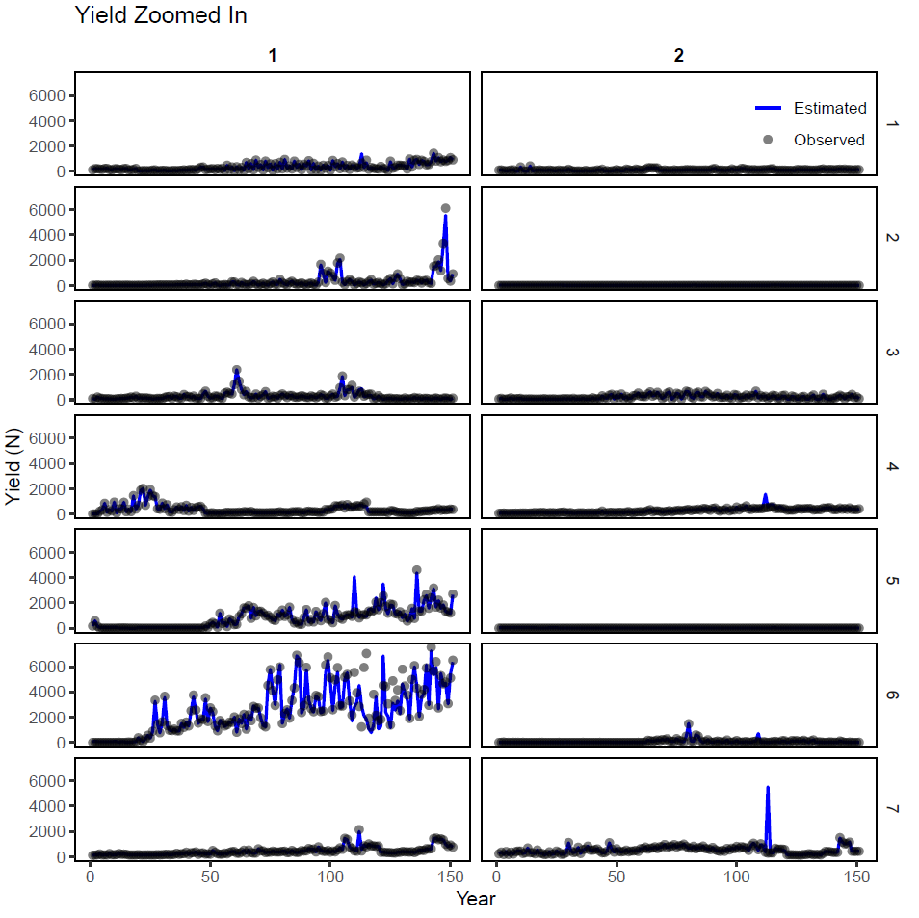
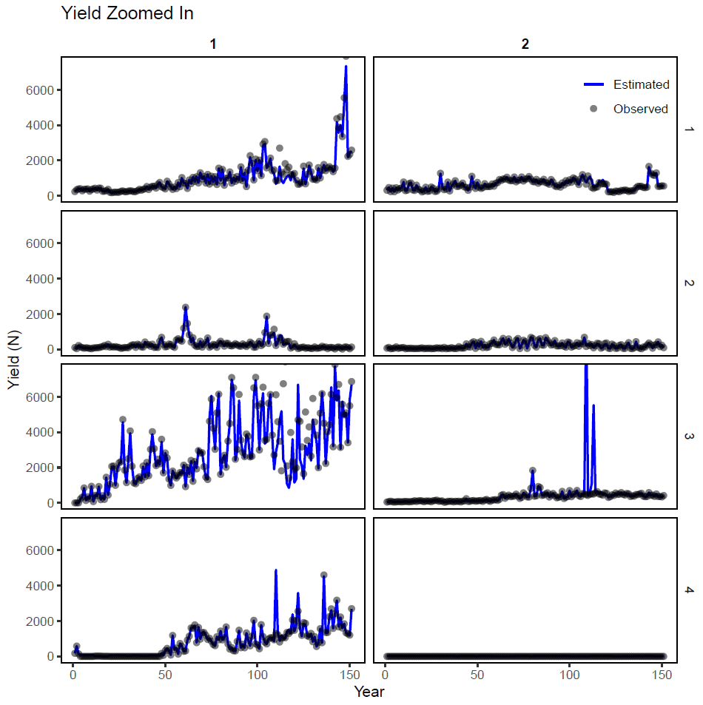
Reduce number of fleets in spatial model
Notes:
Fleet combinations include Purse Seine, Troll, Other; Longline; Gillnet, handline; and bait

Slide 25
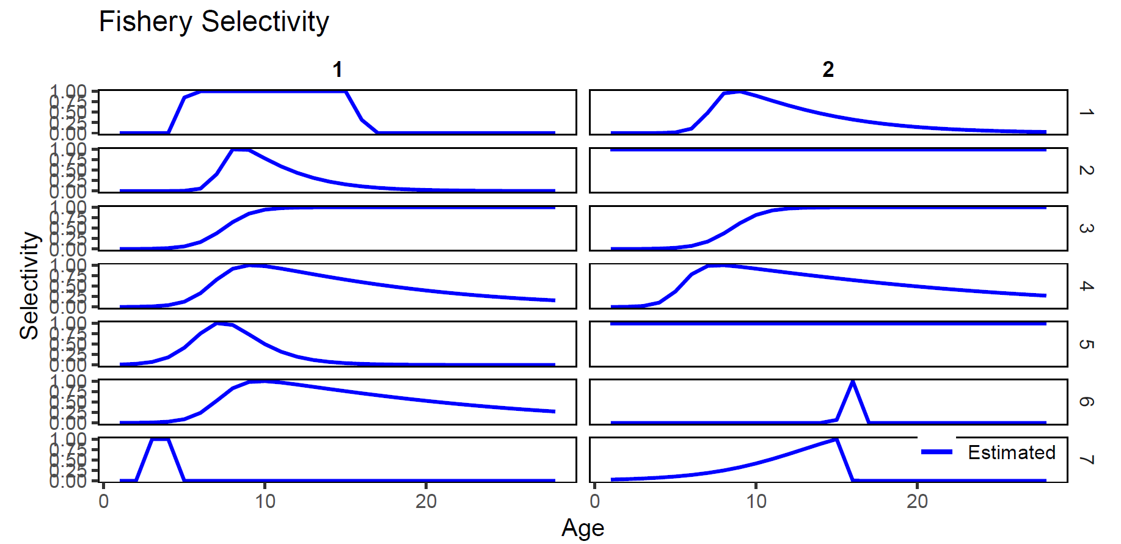
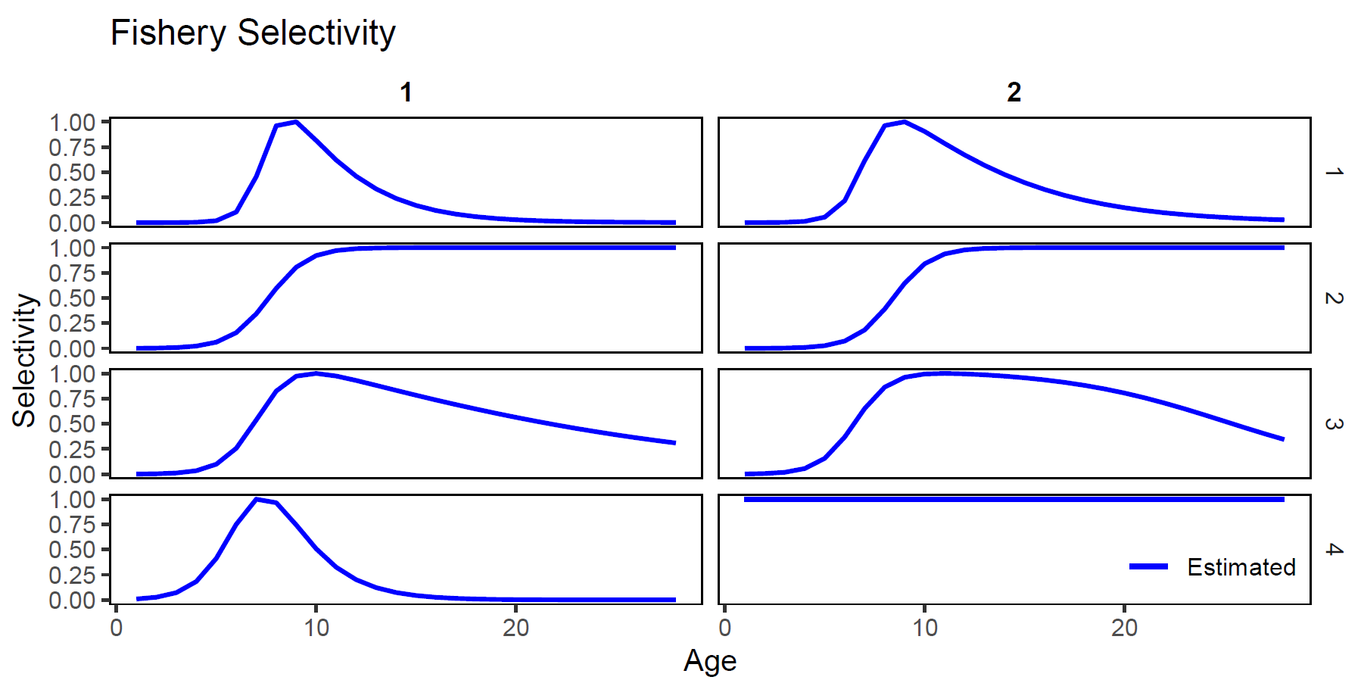
Reduce number of fleets in spatial model
Notes:
Fleet combinations include Purse Seine, Troll, Other; Longline; Gillnet, handline; and bait

